Slide 1
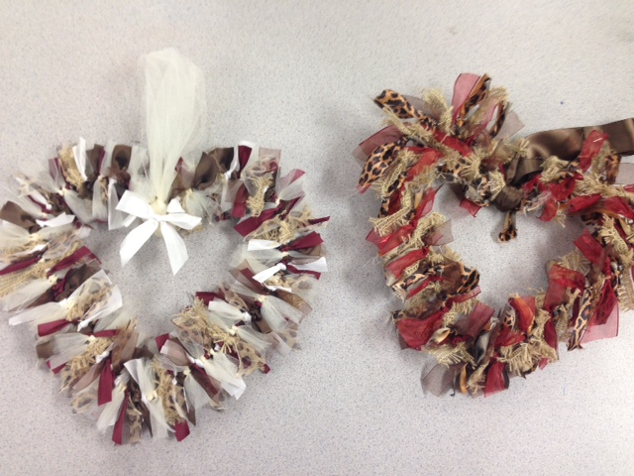
Fabric Heart Wreaths

Slide 2
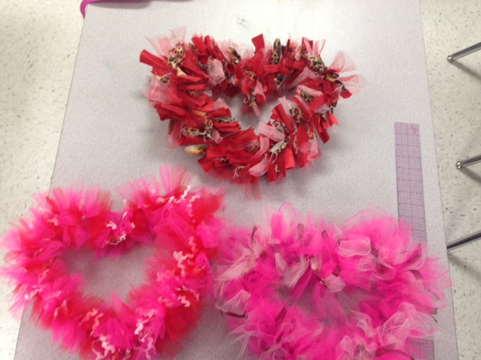
Materials
Fabric strips about 1 to 1 1/2 inch by 5-7 inches long.
Tulle strips and used about a 3 inch by 4 inches long
Coat hanger- Have until tomorrow to bring!

Slide 3
Day 1
Cut the coat hanger’s hook off with wire cutters DO NOT USE SCISSORS!!!
Shape into a heart and tape the connecting pieces with anchor tape

Slide 4
Day 2-3
Pick out your ribbon/fabric and cut into strips about 1 to 1 1/2 inch by 5-7 inches long. Do not go crazy over the length because we will run out of ribbon!
If you picked tulle, cut strips about 3 inches by 4-5 inches long

Slide 5
Day 3-5
Beginning tying a them twice with a simple over and under knot
Fluff them out to look pretty/trim where needed
Reshape hanger as needed

Slide 6
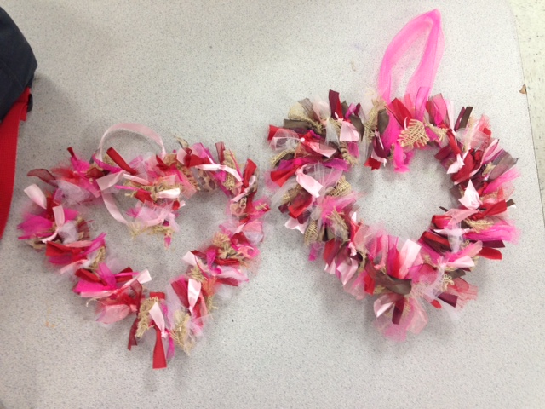
Day 5
Tie the hanger ribbon using a 12 inch piece of tulle ribbon onto the center or hot glue

